Slide 1

Forecasting Economic And Financial Time Series: ARIMA vs. LSTM
Teammates
Upamanyu Pathare
Yutao Shu
Yongsheng Liu
Hexin Xu
Bolun Deng

Slide 2
(Very) Quick Recap
In our previous analysis we noted that LSTM/ARIMA based models perform poorly.
Authors had misunderstood/overstated improvement arising from simple 1-dimensional LSTM models.
We explored more complex on shorter term data to evaluate it’s predictive power.

Slide 3
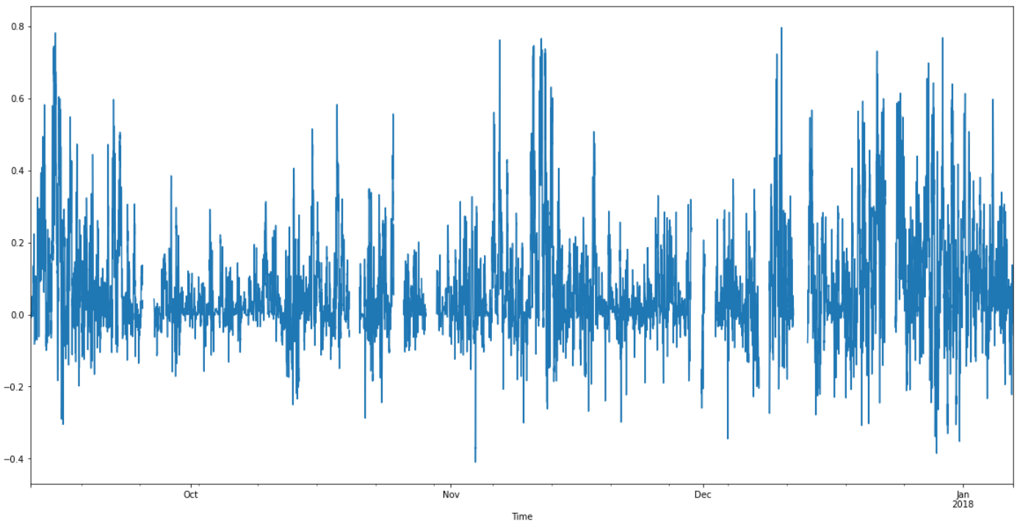
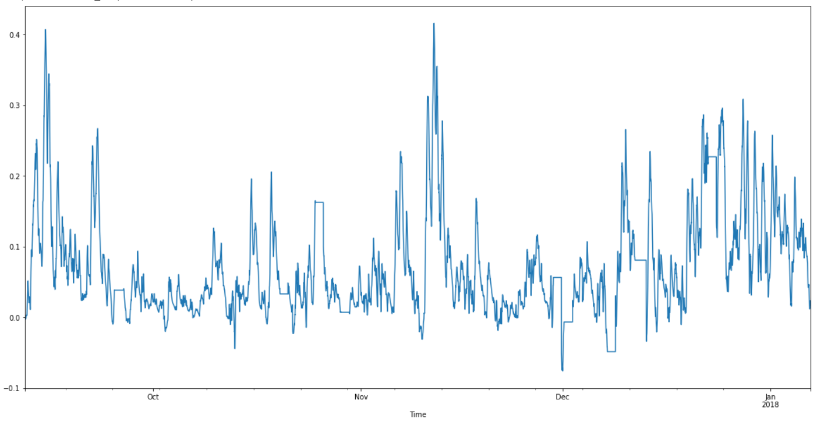
Trading Strategy
The trading strategy uses the signals from the model to trade on the BTC market.
Problem: Signal is too and jittery. Do not want to trade excessively on minor movements.
Solution: Use Exponential Moving Average of return signals to determine trade signals.
Raw Return Signal
EMA Return Signal

Slide 4
Trading Strategy
Problem 2: Do we trade on even the smaller positive (negative) signal? Might not be outside margin of error.
Solution: We only trade if the return signal is larger than some fraction of last day’s volatility. What fraction? Hyperparameter.
Problem 3: Might want to liquidate positions more/less aggressively than entering positions.
Solution: Different signal thresholds for entering and exiting positions.
Finally, to simulate real-life trading as accurately as possible, we include a 0.15% trading cost penalty to each transaction we make (both buy and sell components).

Slide 5
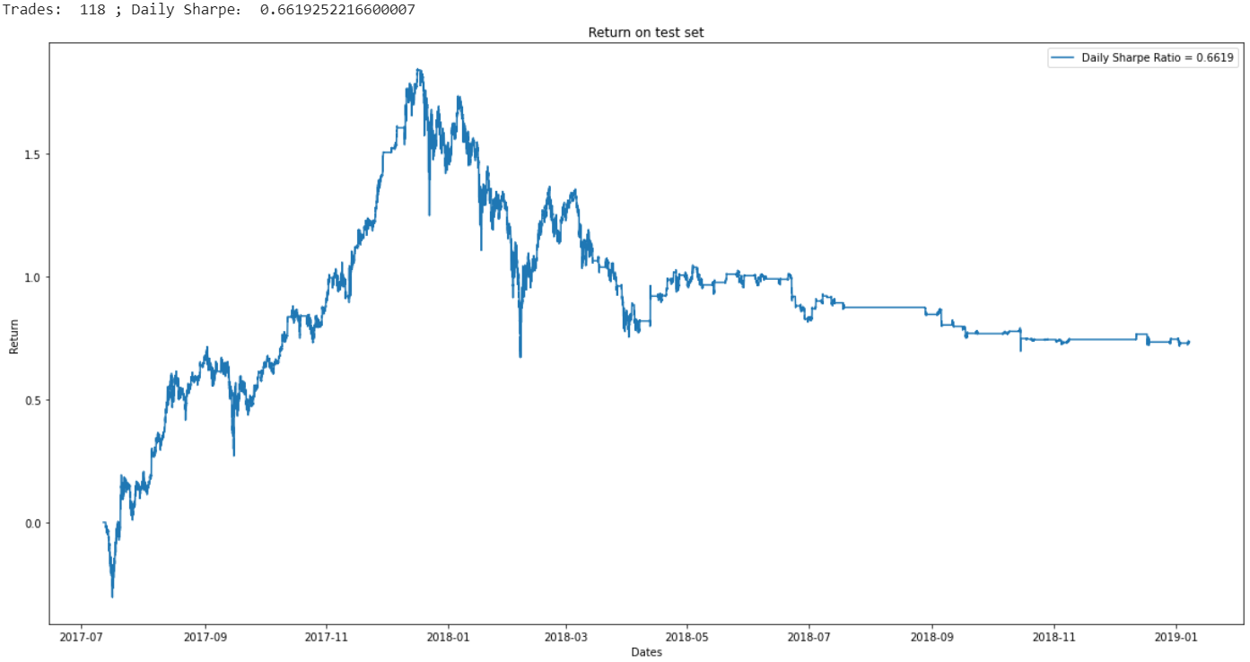
Results
For an initial run, we made an arbitrary choice of hyperparameters.
We open a long (short) position if the predicted positive (negative) return is more than 1 times the previous day’s volatility
We close a position if the predicted return is more (less) than 0.1 times the previous day’s volatility.

Slide 6
Results
We obtain a Sharpe ratio of 0.67 and a cumulative return of 73%. This is slightly better than BTC’s return of 50% over the same period. However, it comes at the cost of a slightly lower SR (0.67 vs 0.83).
This looks good but there is a catch!
Hyperparameter dependent! The hyperparameters here were arbitrarily chosen.
Ideal approach would be to tune hyperparameters on cross-validation set.

Slide 7
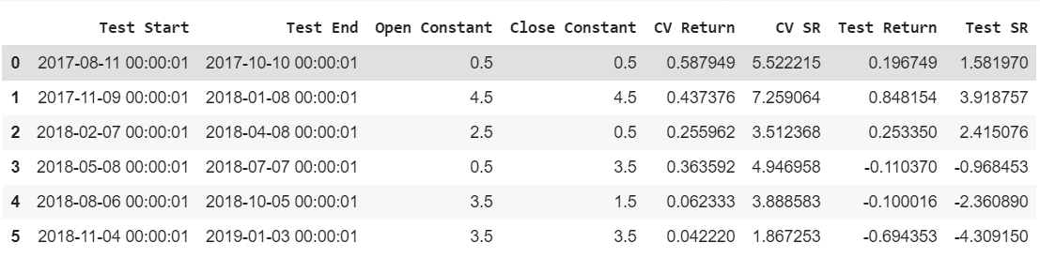
Results
After running a cross-validation approach, we found that the trading strategy is highly dependent on the chosen levels of trading aggressiveness (the open/close constants).
In addition to the explicit hyper parameters, there are several implicit ones. For example:
Length of Recalibration interval (30 days in above results)
Length of Retraining interval (90 days right now)
Finer grid of open/close constants

